Slide 1
Beginning of Nationalism
The revolution and wars created a state of “patriotic dedication” to the “state and national mission”
Various areas of France shared a common language and traditions
Supported the ideas of democracy and popular sovereignty
Shared dangers unified the classes

Slide 2
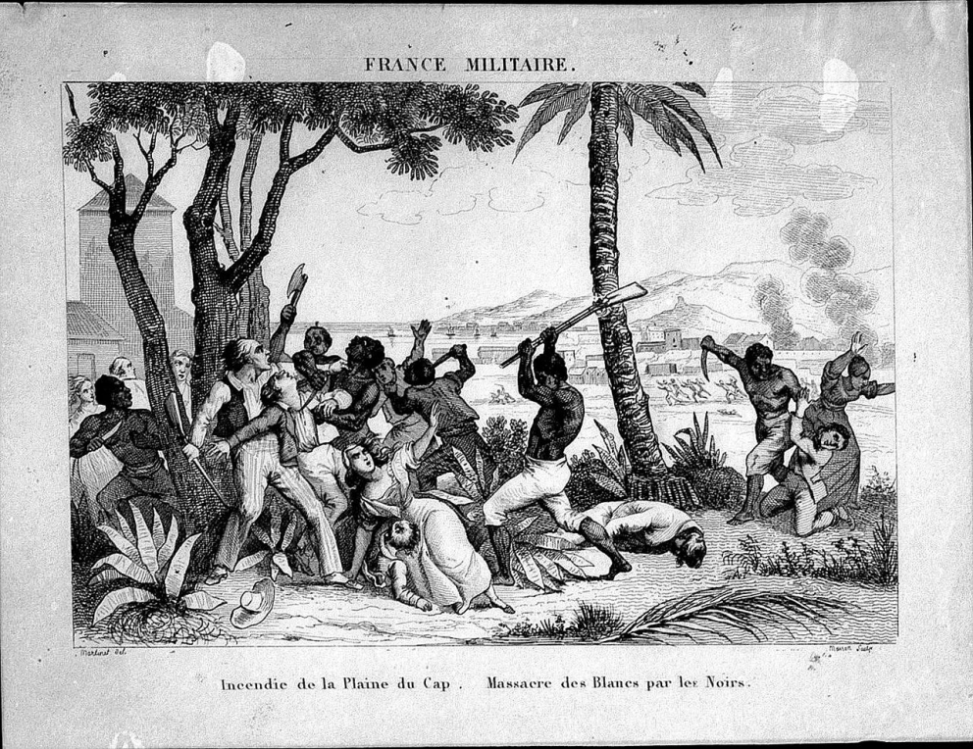
The Haitian Revolution
Slaves of Santo Domingue saw the ideas of the French Revolution as a challenge to slavery
Revolt began in 1791
Over 100,000 slaves joined the revolt
French forces defeated at the Battle of Vertieres on November 18, 1803

Slide 3
The Haitian Revolution
Formal independence of Haiti was declared on January 1, 1804.
Only successful slave revolt in world history
All blacks were given “equal rights” while whites were denied citizenship
Destroyed the economic system
Internal division and heavy debt impoverished the population

Slide 4
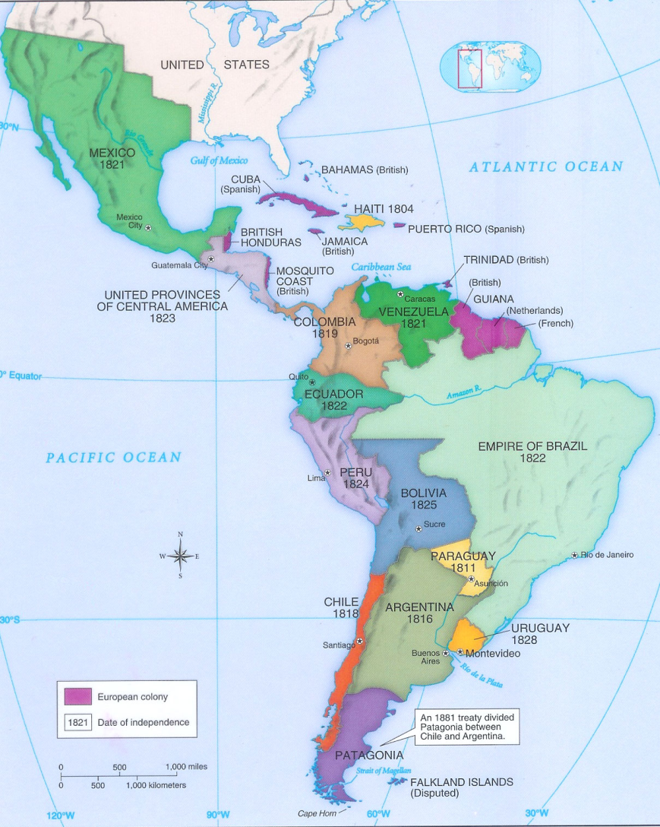
Revolution in Latin America
Argentina from Spain on May 25, 1810
Paraguay from Spain on May 15, 1811
Chile from Spain on February 12, 1818
Columbia from Spain on December 17, 1819
Venezuela from Spain in June 1821

Slide 5

Revolution in Latin America
Peru from Spain on July 28, 1821
Mexico from Spain on September 27, 1821
Ecuador from Spain in May 1822
Brazil from Portugal in January 1824
Bolivia from Spain on August 6, 1825

Slide 6
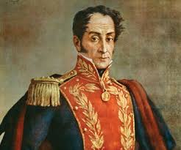
Simon Bolivar
Born on July 24, 1783, into a wealthy Venezuelan family
Sent to Spain and France at the age of 16 for higher education
Exposed to the ideas of the Enlightenment
Led the independence movement for Venezuela, Ecuador, Peru and Bolivia

Slide 7
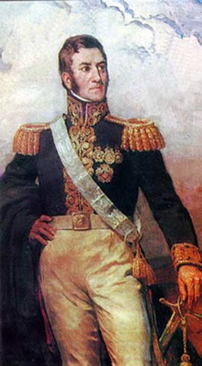
Jose de San Martin
Born in Argentina in 1777 or 1778
Moved to Madrid, Spain as a small child
Enrolled in military school at the age of 11
Returned to Argentina on March 9, 1812
Led the independence movement of Argentina, Chile and Peru

Slide 8
Effects of Latin American Independence
Freedom and independence from Spain
Deprived European nations of their American colonies and resources
Rivalries among groups made unity impossible
Civil wars led to limited resources for local peoples and the rise of strong man politics
Led to the issuance of the Monroe Doctrine by the United States on December 2, 1823

Slide 9
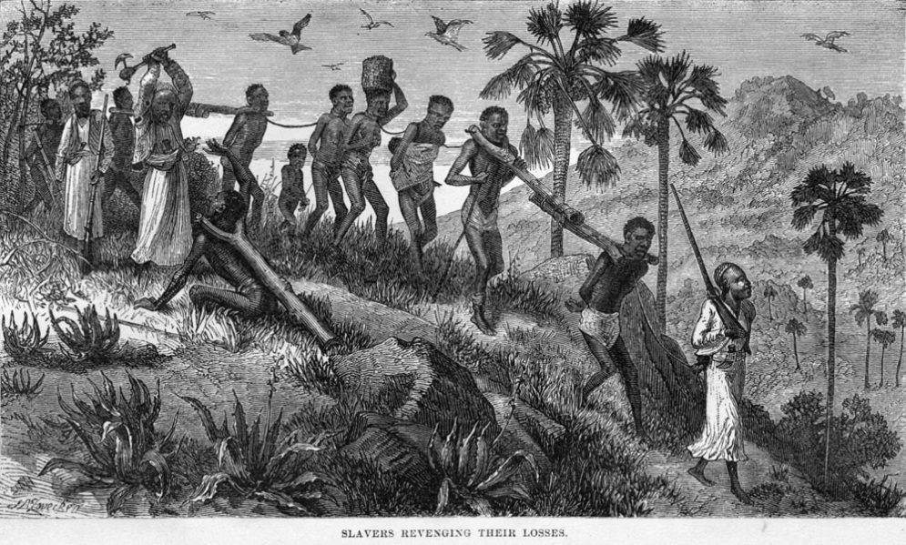
Slavery
The institution of slavery has existed for millennia
The greatest change occurred between 1790 to 1890
Many groups saw the practice as contrary to the ideas of the Enlightenment

Slide 10
Movements Against Slavery
Harsh suppression of slave revolts by the British in their Caribbean colonies created outrage at home
In 1807, Britain prohibited the sale of slaves within its empire
On August 1, 1834, Britain emancipated those remaining enslaved
By the 1850s most Latin American nations had abolished slavery

Slide 11
Nationalism
2nd major radical idea in the years after 1815
Evolved out of an awareness of cultural unity
Became a popular force for change after the French Revolution
Nationalists believed each nationality should have its own government
Became closely associated with liberalism

Slide 12
Ideas of Liberalism
Principle ideas were liberty and equality
A representative government instead of a monarchy
Equality before the law
Individual freedoms
By 1815, liberalism had became associated with the middle class
Became closely associated with nationalism

